Slide 1

BEACON Labs Workshop - Lab 2
Service Worker Cross-Site Scripting Attack Lab
Gaby Dagher, PhD ISPM Research Lab Boise State University
Dylan Gresham ISPM Research Lab Boise State University
Created by: Josh Boyle, ISPM Research Lab
Notes:
Welcome back from the break, let’s get started on the second activity.

Slide 2
Source Paper
Title: Security Study of Service Worker Cross-Site Scripting
Authors: Phakpoom Chinprutthiwong et al.
Conference: ACSAC
Year: 2020

Slide 3
Preparation
Download & Install Oracle VirtualBox
Download Virtual Machine Images
Open the Instruction Document
Start both Virtual Machines
Notes:
Before we get started, please make sure that you’ve got the attacker and defender images imported into virtualbox. Feel free to start the defender machine in headless mode and the attacker machine normally.

Slide 4
WS - SW-XSS: Overview
Service Worker Cross-Site Scripting (SW-XSS)
XSS attacks are both common and dangerous
Service workers caused threat level to go up
“Security Study of Service Worker Cross-Site Scripting” from pages 643-564 in the 36th Annual Computer Security Applications Conference (ACSAC) held in 2020
Notes:
Let’s jump in to the activity. We’ll be learning about an attack known as Service Worker Cross-Site Scripting. This attack was published in a paper in the 36th Annual Computer Security Applications Conference held in 2020 by researchers at Texas A&M. Most importantly though, we need to talk about why we need to learn about this attack. Primarily, cross-site scripting attacks are common and dangerous. Adding service workers into the mix only causes the threat that cross-site scripting attacks pose to go up. Not to mention, cross-site scripting attacks can be incredibly easy to pull off.

Slide 5
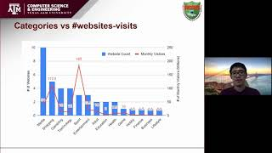
WS - SW-XSS: Overview
Notes:
Let’s jump in to the activity. We’ll be learning about an attack known as Service Worker Cross-Site Scripting. This attack was published in a paper in the 36th Annual Computer Security Applications Conference held in 2020 by researchers at Texas A&M. Most importantly though, we need to talk about why we need to learn about this attack. Primarily, cross-site scripting attacks are common and dangerous. Adding service workers into the mix only causes the threat that cross-site scripting attacks pose to go up. Not to mention, cross-site scripting attacks can be incredibly easy to pull off.

Slide 6
WS - SW-XSS: Task Set 1
DOM-XSS:
DOM = Document Object Model
SW-XSS is an extension of DOM-XSS
Specialized client-side injection attack
Allows injection of scripts into web pages
Possible due to Cross Origin Reference Sharing (CORS) and a lack of URL sanitation
Notes:
Before we can dive into the Service Worker version of cross-site scripting attacks, it’s important to understand the more traditional DOM cross-site scripting attack. DOM cross-site scripting attacks allow the attacker to inject their own malicious scripts into web pages. This type of attack is only possible because of misconfigured CORS and a lack of URL sanitation.

Slide 7
WS - SW-XSS: Task Set 1
CORS:
HTTP-Header technology
Permits origin declaration
Able to block or permit certain types of traffic
URL Sanitation:
Converting special characters into codes
<script>alert(“hi”);</script> turns into
&lt;script&gt;alert(&quot;hi&quot;);&lt;/script&gt;
The first format would be recognized as JavaScript while the second won’t
Notes:
Now that we’ve mentioned why DOM cross-site scripting attacks are possible, let’s look at what exactly those two things are. CORS is a HTTP header technology that allows a website to say “hey I only want traffic from these people and no one else” or “I only want this specific format of traffic.” URL Sanitation on the other hand is simply the process of converting special characters into codes so that the browser doesn’t try and parse and execute code input into user input boxes such as in a form, email, or, as we’ll see later, URLs.

Slide 8
WS - SW-XSS: Task Set 1
How would we perform a DOM-XSS?
Find a vulnerable web page
Enter JavaScript into the URL
Press “Enter” to submit the new URL and watch the JavaScript that you entered be executed
Notes:
Now that we’ve defined what a DOM-XSS attack is and why it’s possible, how do we actually pull one off? Well all we need to find a vulnerable web page where we can input JavaScript and have the browser execute it. This can be done by just going around to websites and inputting small snippets of JavaScript into any user input boxes such as search bars, comments, form fields, or the URL itself until we actually get out JavaScript executed.

Slide 9
WS - SW-XSS: Action 1.1.1
What is the source and sink of the website associated with the DOM-XSS bookmark?
Notes:
We’re now at our first action. Sources and sinks are defined more in the instruction document but I’ll give a brief explanation here. A source is somewhere that the data is coming from such as a file, database, URL parameters, or the user themselves. The sink is where that data is then utilized. Sinks can be something as simple as a function or as complex as a whole data pipeline. Take 5 minutes to read the instruction document’s description of sources and sinks and then figure out what they are for the DOM-XSS bookmark in the attacker virtual machine.

Slide 10
WS - SW-XSS: Action 1.1.1
What is the source and sink of the website associated with the DOM-XSS bookmark?
The source of this website is the context URL parameter which determines the name to write within the body. Therefore, the sink in this case is the HTML page’s body or the script tag that reads the context parameter of the URL, either one are acceptable answers.
Notes:
Now that five minutes are up, I hope that you said the source is the context URL parameter where we input the name that goes within the body of the webpage and the sink is the page’s body or, more specifically, the script tag that reads the context parameter.

Slide 11
WS - SW-XSS: Action 1.1.2
Craft a URL with the JavaScript alert function to test for a DOM-XSS attack.
Notes:
Moving on, take five minutes to create a URL with a JavaScript alert function to test if this webpage is vulnerable to a DOM-XSS attack.

Slide 12
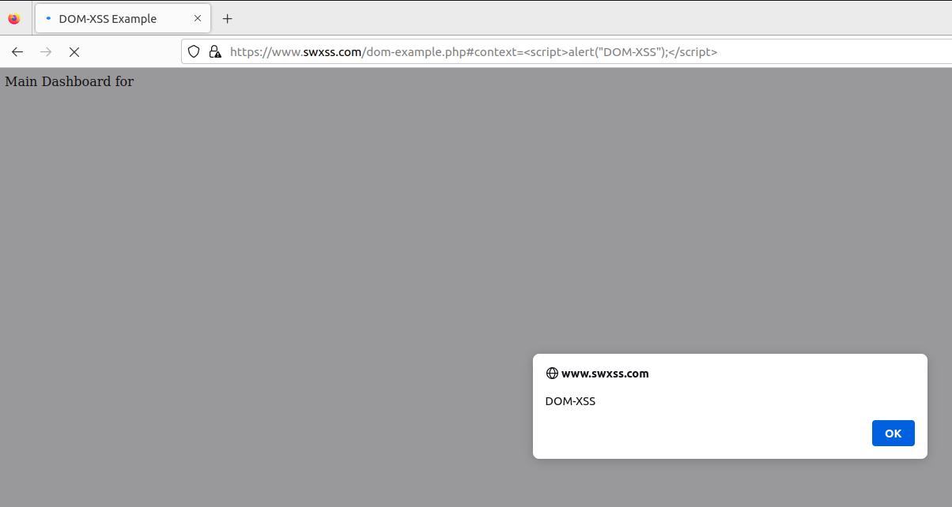
WS - SW-XSS: Action 1.1.2
Craft a URL with the JavaScript alert function to test for a DOM-XSS attack.
https://www.swxss.com/dom-example.php#context=<script>alert(“DOM-XSS”);</script>
Notes:
Now that five minutes are up, we can see the orange part of the URL shows us inputting a HTML script tag with JavaScript within. When the page is loaded with this type of URL we then get an alert box that reads “DOM-XSS” within it. This proves that the webpage is vulnerable to a DOM cross-site scripting attack.

Slide 13
WS - SW-XSS: Task Set 1
What can we do to abuse DOM-XSS?
Import scripts from an external server
The attacker can modify these scripts!
Notes:
Now that we’ve gone over the basics of DOM cross-site scripting attacks, let’s think about it more in depth. What can we do to abuse this vulnerability? The slide spoils it but an attacker can most definitely import external scripts over the internet. Since these are external scripts that means the attacker can modify them to do whatever they want. This could range from being as basic as Rick Rolling a user to as complex as starting a hidden background download of a malicious payload.

Slide 14
WS - SW-XSS: Action 1.2.1
Craft a new URL using an <img> tag and an image hosted on the site https://www.attacker.com.
Notes:
To exemplify this, craft a URL using an HTML image tag to load an image hosted on the attacker’s website. Take 5 minutes to give this a shot and then we’ll reconvene.

Slide 15
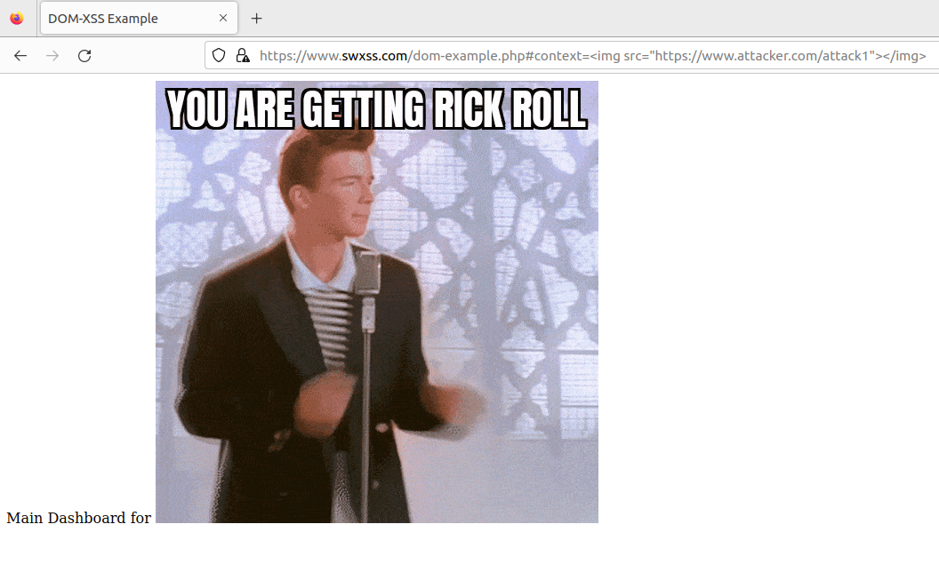
WS - SW-XSS: Action 1.2.1
Craft a new URL using an <img> tag and an image hosted on the site https://www.attacker.com.
https://www.swxss.com/dom-example.php#context=<img src=”https://www.attacker.com/attack1”></img>
Notes:
If you were able to get this on your own, congratulations! If not, you’ve been rick rolled, I apologize. Anyways, here we can see that in the context parameter we define an image tag with the src being the attack1 image hosted on the attacker’s website. This then replaces what would normally be the user’s name with an image of Rick Astley.

Slide 16
WS - SW-XSS: Task Set 1
Navigate to the “Sanitized” bookmark
Craft a URL with the JavaScript alert function to test for a DOM-XSS attack like we did in Action 1.1.2
Observe the sanitized URL after navigating the the crafted URL
Notes:
Now that we’ve played around with a vulnerable website, let’s look at what a properly built website with URL sanitation might look like. Navigate to the bookmark labeled “Sanitized” and try to write a URL with an alert function like we did previously. After reloading the page with your malicious URL, take a look at what happens to the URL after the page has been loaded. Notice how the characters have been mangled and it no longer looks like JavaScript? This is what URL sanitization is.

Slide 17
WS - SW-XSS: Task Set 2
Time for the SW-XSS!
But first, what is a Service Worker??
Web workers
JavaScript files running in a separate thread on the browser
Network traffic interception, session persistence, instant push notifications
Notes:
We’ve established the basics so now let’s get into Service Worker cross-site scripting. But first off, what is a service worker? Well service workers are simply web workers. Think of them like a thread spawned by the browser that executes a JavaScript file. These workers are mostly used to intercept network traffic, persist sessions, or provide instant push notifications. As we’ll see in this activity, there’s more you can do with them from an attacker’s perspective.

Slide 18
WS - SW-XSS: Task Set 2
Service Worker Lifecycle
Notes:
One essential thing to know about Service Workers are their lifecycle.

Slide 19
WS - SW-XSS: Task Set 2
Registration
Requires the file path to the SW and may or may not determine its control scope
Critical point, only occurs once!
Notes:
The first event is registration in which the file path to the JavaScript code representing the service worker is provided and may or may not determine its control scope. What do we mean by control scope? Control scope limits the service worker to specific pages within the website so a single service worker may only work on the home page but not on the create account page. Keep in mind, this event only happens once though.

Slide 20
WS - SW-XSS: Task Set 2
Installation
Only happens if a new file is imported
Notes:
Next is the installation phase. This only happens the first time a new file is imported as a service worker.

Slide 21
WS - SW-XSS: Task Set 2
Activation
Service worker is alive!
Handles all programmed events
Remains active until the user stops it or the defined task is finished.
Restarts all tasks once activated again.
Notes:
After installation is the activation phase. This is where the service worker comes alive and does what it’s programmed to do. The service worker will continue to run until either the user stops it or its task is finished.

Slide 22
WS - SW-XSS: Action 2.1.1
What are the three steps in a service worker’s life cycle and how
do they impact the execution of the SW-XSS attack?
Notes:
Now let’s take a break and recap what we just went over. Take five minutes to summarize what you know about the three steps in a service worker’s life cycle and theorize about how they impact the execution of a service worker cross-site scripting attack.

Slide 23
WS - SW-XSS: Action 2.1.1
What are the three steps in a service worker’s life cycle and how
do they impact the execution of the SW-XSS attack?
The three steps are Registration, Installation, and Activation. These steps impact the execution of a SW-XSS attack by limiting when the attacker can replace the standard service worker file with their own malicious file.
The attacker’s service worker script would need to be imported into the website prior to the Registration event firing and pointed to in an event listener in the Installation phase.
Notes:
I hope you said that the three steps are registration, installation, and activation. Some of the ways that these steps impact the execution of a service worker cross-site scripting attack could be limiting when the attacker can replace the standard file with their own file, which would have to happen prior to the registration event and then pointed to in the installation phase.

Slide 24
WS - SW-XSS: Task Set 2
SW-XSS Overview
Source and Sink approach
Leverages:
importScripts() sink function to import external JavaScript into the current file
CORS to fetch external scripts
Notes:
Let’s take a look at the service worker attack from a source and sink approach. We’ll be utilizing the JavaScript function import scripts as the sink function to import external JavaScript into the current worker file. This is only possible because CORS is allowing us to fetch the external script.

Slide 25
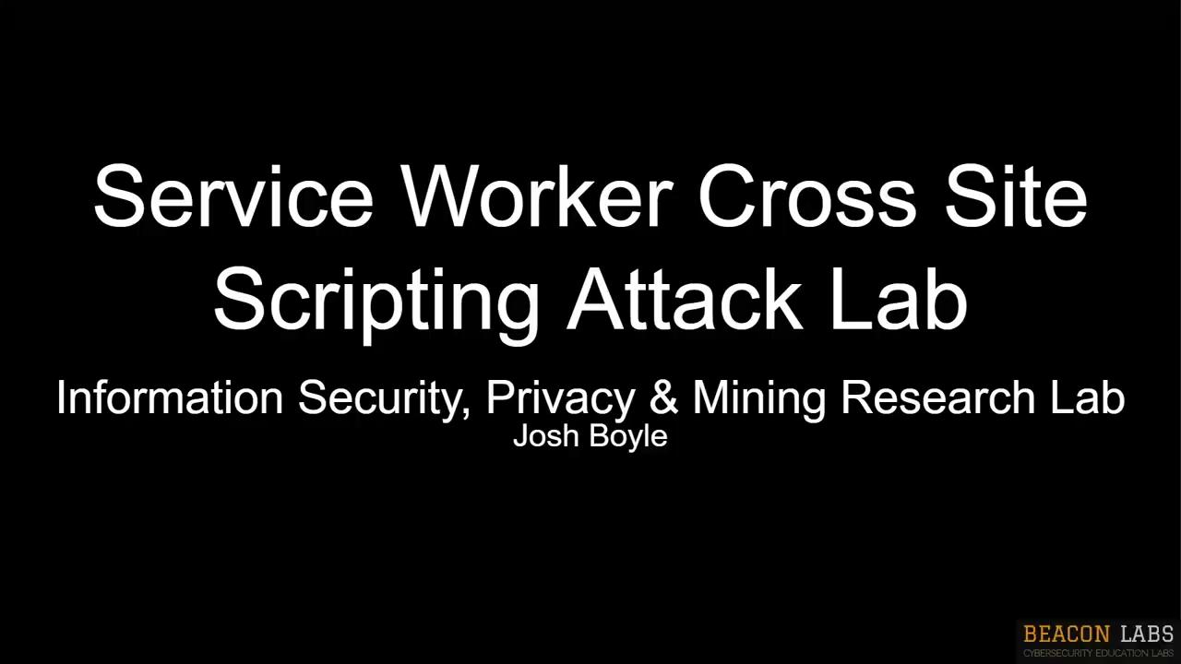
WS - SW-XSS: Task Set 2
Notes:
Now let’s watch a video from Josh to show you how to work with service workers.

Slide 26
WS - SW-XSS: Action 2.3.1
Open a new Firefox tab to the “SW-XSS” bookmark. Inspect the web page, click the application tab, and click on sw.js. What is the source and sink?
Notes:
Thanks Josh. Now let’s open up a tab to the SW-XSS bookmark, inspect the web page and navigate to the debugger tab. In the debugger tab, click on the sw JavaScript file and determine what is the source and sink. Take 5 minutes to do this and then we’ll meet back up.

Slide 27
WS - SW-XSS: Action 2.3.1
Open a new Firefox tab to the “SW-XSS” bookmark. Inspect the web page, click the debugger tab, and click on sw.js on the far right. What is the source and sink?
The source is the sw_fn.js file stored in the machine somewhere and the sink is the fetching function where it is being read in.
Notes:
Hopefully you were able to find that the source is the sw_fn.js file which is stored somewhere on the machine and the sink is the fetch function where that file is being read in.

Slide 28
WS - SW-XSS: Action 2.3.2
Open a new terminal and create a new file at /var/www/html/sw_fn.js with the touch command as the super user. Insert a personalized console message with a console.log function call.
Remove the old service worker and reload the SW-XSS page. Navigate back to the debugging page and observe the console output.
Notes:
Now open a terminal and navigate to the /var/www/html directory and create a new file as the sudo user. You’ll have to rename the old sw_fn.js file with the mv command and then rename your newly created file to sw_fn.js also with the mv command. Once you’ve got your new file created, open it with a text editor of your choice such as nano or vim and write a console.log function call with a message of your choice. Once done, save and write the file then back in Firefox remove the old service worker using the steps Josh showed us and reload the page to observe your new service worker’s output in the console under the debugging page. Take 10 minutes to give this a shot.

Slide 29
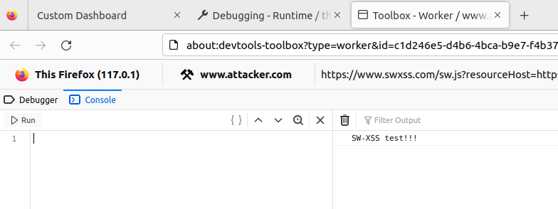
WS - SW-XSS: Action 2.3.2
Open a new terminal and create a new file at /var/www/html/sw_fn.js with the touch command as the super user. Insert a personalized console message with a console.log function call.
Remove the old service worker and reload the SW-XSS page. Navigate back to the debugging page and observe the console output.
Notes:
If you were able to get it working, you should see something similar to this. If not, pause and keep working at it until you’ve got it.

Slide 30
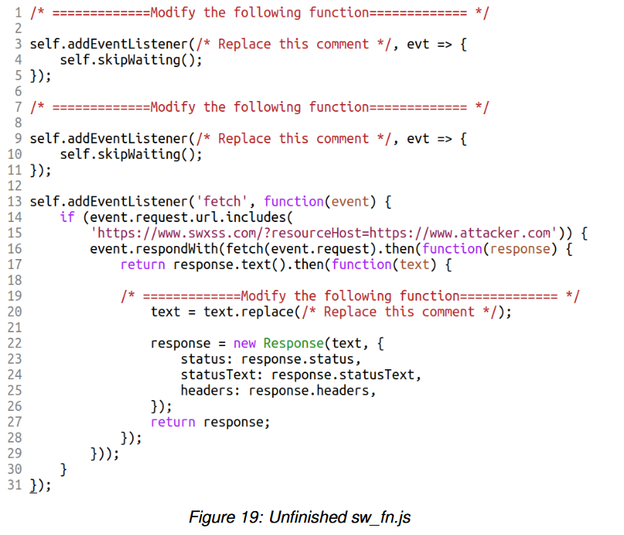
WS - SW-XSS: Task Set 2
Notes:
Here’s the unfinished service worker that we need to use. In this code, self refers to the webpage itself. We first add an event listener for some event that you’ll need to fill in which then just tells the webpage to skip waiting. We do the same thing for the next lifecycle event as well. Finally, we add an event listener for the fetch event in which we’ll need to replace some HTML with our malicious HTML.

Slide 31
WS - SW-XSS: Action 2.3.2
In the file sw_fn.js, edit the functions to add the install, activate, and fetch handlers. Add a console.log to each function and observe the log output.
Notes:
Take 5 minutes to edit the service worker file with some console log messages and then reconvene.

Slide 32
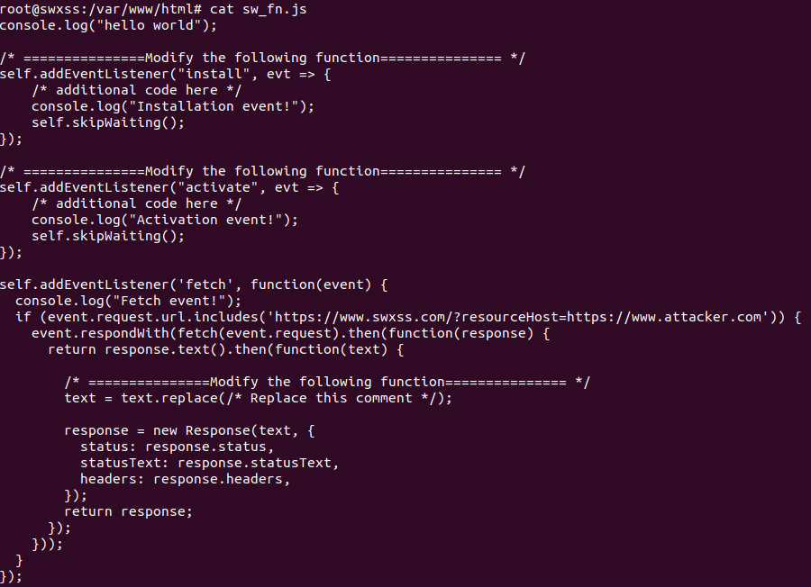
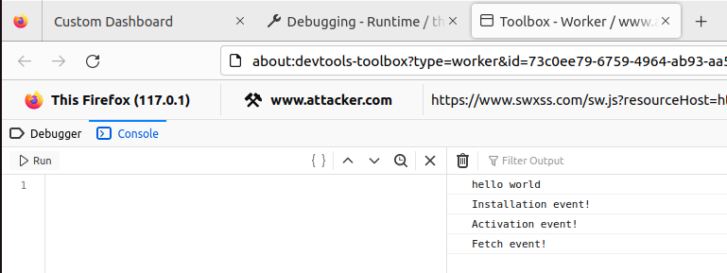
WS - SW-XSS: Action 2.3.2
In the file sw_fn.js, edit the functions to add the install, activate, and fetch handlers. Add a console.log to each function and observe the log output.
Notes:
As you can see in the JavaScript functions on the left, we’ve modified the install, activate, and fetch events to now include some console logs. In the debugger’s console on the right we can see these messages being output.

Slide 33
WS - SW-XSS: Action 2.3.2
In the same file, edit the fetch handler function to replace an HTML element on the SW-XSS page like we did in the DOM-XSS section.
Notes:
Now let’s take 20 minutes to edit the fetch handler to replace the submit button on the web page with an image, similar to what we did with the DOM cross-site scripting attack.

Slide 34
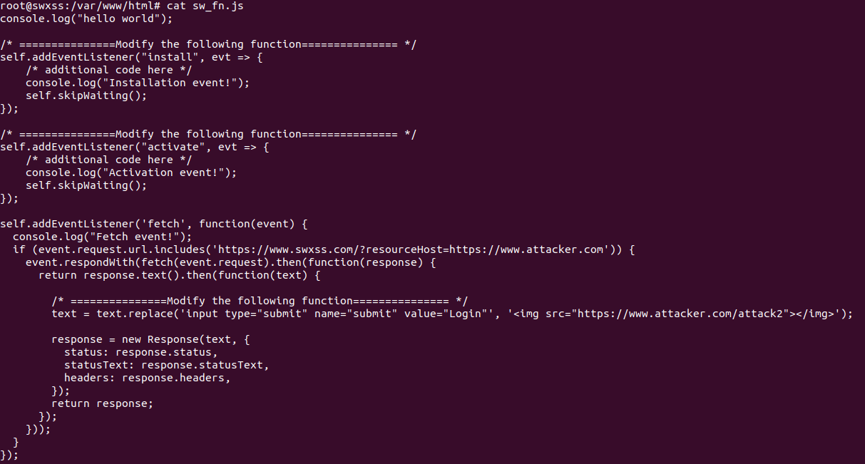
WS - SW-XSS: Action 2.3.2
Notes:
As you can see here, we tell the web page to skip waiting for the install and activate events and then on the fetch event we fetch from our attacker’s website and replace the submit button with an image from our attacker’s website.

Slide 35
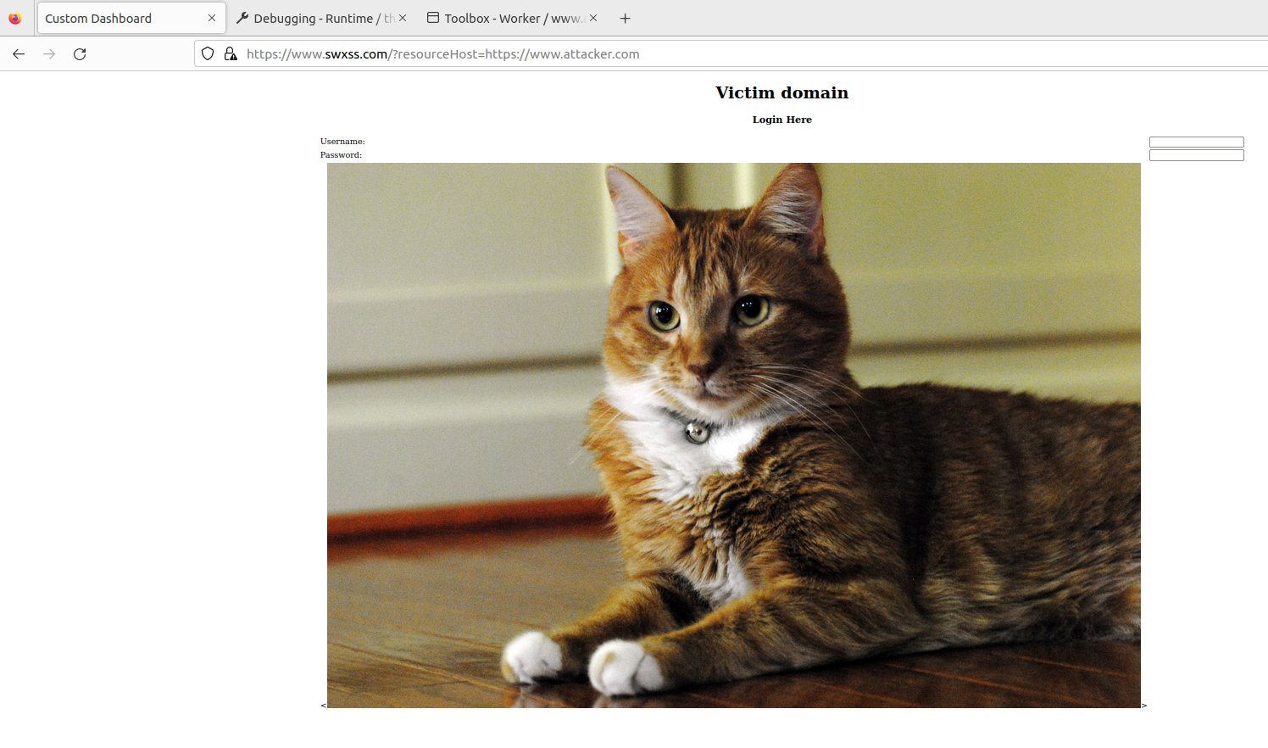
WS - SW-XSS: Action 2.3.2
Notes:
And in the web page itself we can see that the image is being shown where the button normally would be.

Slide 36

WS - SW-XSS: Task Set 3
Notes:
Now before we dive into the final section on Game Theory, let’s watch a video from William Spaniel about Pooling Equilibrium.

Slide 37
WS - SW-XSS: Task Set 3
Our Scenario
Signaling Game
Developer = Player 1 (p1)
Attacker = Player 2 (p2)
Website has a service worker installed
Players have a choice of 2 actions
P1 can either sanitize the URL params or “forget to”
P2 can either attack or move on
P1 can be either an experienced or inexperienced developer (nature)
Notes:
In our scenario, we have a signaling game in which the developer is player one and the attacker is player 2. The website has a service worker installed and the players each have a choice of two actions. The developer can either sanitize the URL or forget to do so. The attacker can choose to either attack or move on. Additionally, the developer has a nature, either experienced or inexperienced.

Slide 38
WS - SW-XSS: Task Set 3
Strategies
Developer
Sanitize
Attacker
Attack if developer does not sanitize
Ignore when experienced dev sanitizes
Different attack when inexperienced dev sanitizes
Attacker’s Belief
47% chance of experienced dev
53% chance of inexperienced dev
Notes:
If we look at the outcomes, we can see that the developer’s strategy is to always sanitize. The attacker on the other hand has multiple strategies. If the attacker believes that the developer didn’t sanitize, they will attack. If the attacker thinks that it was an experienced developer that did the sanitization, they shouldn’t attack. But, if the attacker believes that it was an inexperienced developer that did the sanitization, they should try a different attack since the inexperienced developer might not have handled edge cases. The attacker’s strategies hinge on the attacker’s belief that there’s a 47% chance that the developer is experienced and a 53% chance that the developer is inexperienced.

Slide 39
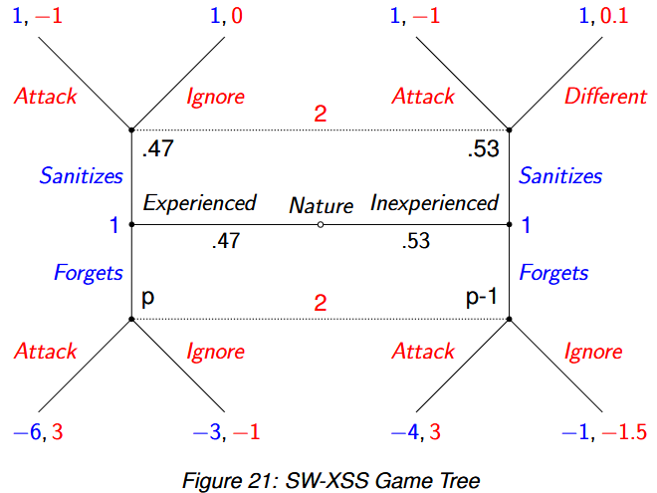
WS - SW-XSS: Task Set 3
Game as a Tree
Notes:
Here we can see this game represented as a tree. To read the tree, we start from the middle where it says “Nature.” If we’re an experienced developer, we move to the left. Since the developer’s strategy is to always sanitize, we then move up. Now that we’re an experienced developer who has sanitized, the attacker’s strategy is to ignore, leading to a gain of 1 for the developer and a gain of 0 for the attacker. In this case, the developer is said to have won.

Slide 40
WS - SW-XSS: Action 3.1.1
Calculate the attacker’s expected utility for this game.
Notes:
Take 5 minutes to try and calculate the attacker’s expected utility for this game.

Slide 41
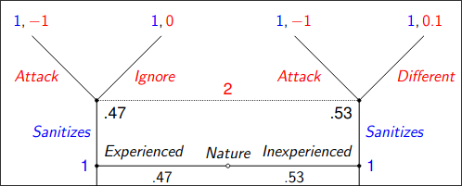
WS - SW-XSS: Action 3.1.1
Calculate the attacker’s expected utility for this game.
Pooling game since devs will always sanitize
Attacker will choose to ignore if experienced dev or attempt a different attack if inexperienced
Bottom half of tree can be eliminated since we know P1’s action
Notes:
Our first step here is to determine what kind of a game this is. Since the developers will always sanitize, we have a pooling strategy, making this a pooling game. The attacker will then choose to ignore or attempt a different attack based on the developer’s nature. We can safely eliminate the entire bottom half of this tree and only focus on the top half when the developer sanitizes.

Slide 42
WS - SW-XSS: Action 3.1.1
Calculate the attacker’s expected utility for this game.
E(P2’s utility) = (P(experienced) * U(ignore)) + (P(inexperienced) * U(different))
E(P2’s utility) = (0.47 * 0) + (0.53 * 0.1) = 0.053
Notes:
From this, we can take the probability of each nature multiplied by the utility that the attacker would gain from taking the non-attack action and sum them together, getting an expected utility of 0.053.

Slide 43
WS - SW-XSS: Action 3.1.2
What does the expected utility tell about the attacker’s decision?
Notes:
Now that we have the attacker’s expected utility, take 5 minutes to think about that this means about the attacker’s decision.

Slide 44
WS - SW-XSS: Action 3.1.2
What does the expected utility tell about the attacker’s decision?
0.053 is a very low value but still positive, this tells us that the attacker’s decision will be of benefit to the attacker, and likewise of detriment to the developer, but will not hold much value.
Notes:
Well, since the expected utility is a very low positive value, this tells us the attacker’s decision will be of benefit to the attacker and likewise harm the developer but not in a major way. This could be something like the attacker gaining information on what kind of infrastructure the website is hosted on or some other arbitrary piece of information that ultimately doesn’t mean all that much.

Slide 45
WS - SW-XSS: Action 3.1.3
Calculate the expected utility for P2 if P1 chooses the forget option.
Notes:
Now let’s look at what the expected utility for the attacker is if the developer chooses to deviate from their strategy. Take 5 minutes to calculate this expected utility.

Slide 46
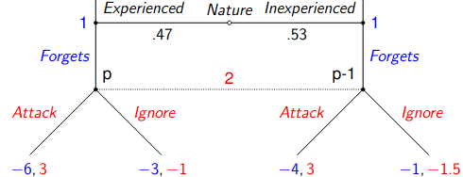
WS - SW-XSS: Action 3.1.3
Calculate the expected utility for P2 if P1 chooses the forget option.
E(P2’s utility) = (P(experienced) * U(attack)) + (P(inexperienced) * U(attack))
E(P2’s utility) = (0.47 * 3) + (0.53 * 3) = 3
Notes:
Doing the same process as before but for the bottom half of the tree, we can see that the attacker’s expected utility is 3. This would mean that if the developer deviates from their strategy, the attacker would be able to do some serious damage.

Slide 47
WS - SW-XSS: Action 3.1.4
Does this game have an equilibrium? Explain your reasoning.
Notes:
Now let’s see if this game has an equilibrium. Take 15 minutes to reason out if it does or doesn’t.

Slide 48
WS - SW-XSS: Action 3.1.4
Does this game have an equilibrium? Explain your reasoning.
2 different pooling strategies:
P1 chooses to sanitize regardless of nature.
P2 will always choose the non-attack option resulting in an expected utility of 1 for P1.
P1 chooses to forget regardless of nature.
P2 will always choose the attack option resulting in an expected utility of -4.94 for P1.
Notes:
To determine if there’s an equilibrium, we first need to look at the two different pooling strategies. In the first strategy, the developer chooses to sanitize regardless of their nature. In this case, that attacker will choose the non-attack option, resulting in an expected utility of 1 for the developer. Do note that this is the expected utility of the developer, not the attacker’s expected utility which we calculated in action 3.1.1. In the second strategy, the developer chooses to forget to sanitize regardless of their nature. In this situation, the attacker will always choose the attack option, resulting in an expected utility of negative 4.94 for the developer.

Slide 49
WS - SW-XSS: Action 3.1.4
Does this game have an equilibrium? Explain your reasoning.
Determine if there’s a profitable deviation
If P1 is an experienced dev:
P2 will ignore if P1 sticks to equilibrium strategy and sanitizes. This results in a payoff of 1 for P1
If P1 deviates, P2 will always attack resulting in a payoff of -6 for P1
Based on the above two points, if P1 is an experienced dev, there’s no profitable deviation.
If P1 is an inexperienced dev:
P2 will choose a different attack if P1 sticks to equilibrium strategy and sanitizes. This results in a payoff of 1 for P1
If P1 deviates, P2 will always attack resulting in a payoff of -4 for P1
Based on the above two points, if P1 is an inexperienced dev, there’s also no profitable deviation.
Since there’s no profitable deviation, there is a pooling equilibrium for this game.
Notes:
Now we need to determine if there’s a profitable deviation. If the developer is experienced, the attacker will ignore if the developer sticks to the equilibrium strategy and sanitizes, resulting in a payoff of 1 for the developer. If the developer deviates, the attacker will always attack resulting in a payoff of negative 6 for the developer. Based on these two points, if the developer is experienced, there’s no profitable deviation. Similarly for the inexperienced developer, we see that there’s a payoff for the developer of 1 if they stick to the equilibrium strategy and a payoff of negative 4 if they deviate, also pointing to there being no profitable deviation. Since we’ve determined that there’s no profitable deviation, we can conclude that there is indeed a pooling equilibrium for this game.

Slide 50
WS - SW-XSS: Summary
Learned what Service Workers are.
Learned how the SW-XSS attack works and what makes it possible.
From that, we’ve learned what needs to be done to prevent it.
Demonstrated how simple oversights can lead to extreme issues.
Notes:
To summarize what you’ve learned in this activity: You’ve learned what a service worker is, how the service worker cross-site scripting attack works and how its possible. From this, you’ve learned what needs to be done to prevent it and we’ve demonstrated how simple oversights can lead to detrimental consequences.

Slide 51
Questions?
Wrap-up
Notes:
Please fill out the form on Canvas! If you have any questions there is a question on the form where you can put them and I will send you an email with the answers to your questions.

Slide 52
Thank you for participating in this activity!
WS - SWXSS

